Slide 1

Social Buzz: Data Insights for Content Strategy
Presented by: Sujan Tumbaraguddi BI Analyst, Accenture
(Job Simulation)

Slide 2
Agenda
Project Recap The Challenge Our Team Our Process Key Insights Top 5 Categories Popularity Share Summary & Next Steps

Slide 3
Project Recap
Social Buzz: A global unicorn with massive content scale 100,000+ posts daily, 36.5M annually Accenture’s 3-month pilot:
- Big data practice audit - IPO guidance - Data analysis for top 5 content categories Goal: Optimize content strategy via data insights

Slide 4
The Challenge
Massive unstructured data: 36.5M posts/year Challenge: Understanding audience preferences Why it matters: - Content is king - Insights enable personalized user experiences Our role: Uncover actionable insights from data

Slide 5
Our Team
Andrew Fleming: Chief Technology Architect Guided high-quality analysis Marcus Rompton: Senior Principal Expert in data engineering Sujan Tumbaraguddi: BI Analyst Led insight generation and visualization

Slide 6
Our Process
5-Step Approach:
Data Understanding: Studied Social Buzz’s data model Data Cleaning: Prepared datasets for analysis Data Modeling: Structured data for insights Data Analysis: Uncovered trends and patterns Data Visuals: Developed insights into recommendations

Slide 7
Key Insights
16 unique categories (e.g., Food, Science, Animals) 1897 reactions to Animal posts, showing high engagement January: Most active month Likely due to post-holiday social activity

Slide 8
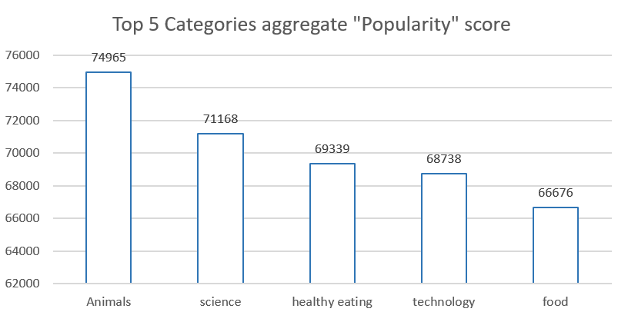

Top 5 Categories
Top 5 by Popularity Score: - Animals: ~74,965 - Science: ~71,168 - Healthy Eating: ~69,339 - Technology: ~68,738 - Food: ~66,676 Food-related categories show strong engagement.

Slide 9
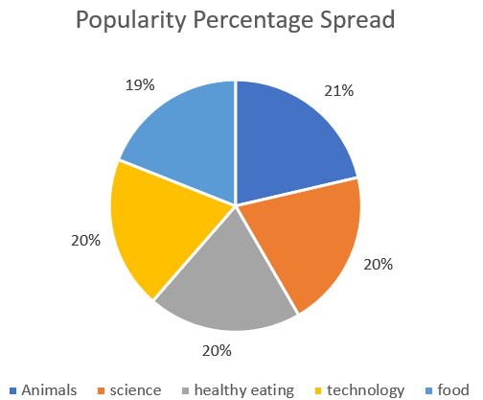
Popularity Share
Popularity Split Among Top 5:
- Animals: Highest share - Science: 1.1% less than Animals - Healthy Eating, Technology & Food: Closely distributed Risk:
Animals content might dominate without balanced algorithms.

Slide 10
Key Insights: - Technology & Science lead, show users prefer for real-life & factual content. - Healthy Eating outranks Food, which indicates users are health-conscious. Recommendations: - Organize Healthy Eating campaigns with the brands by partnerships. - Balance content algorithms to prevent category like animals' dominance over others. - Scale live-analytics using sample dashboard created for ongoing insights. Next Steps:
Organize projects with Accenture for production-scale live-analytics.
Summary & Next Steps

Slide 11
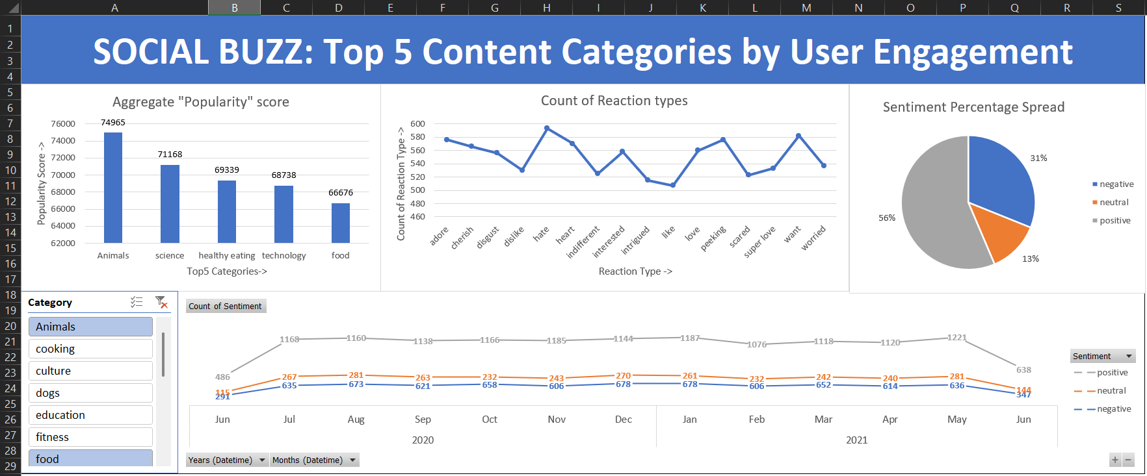
Sample Dashboard

